Slide 1
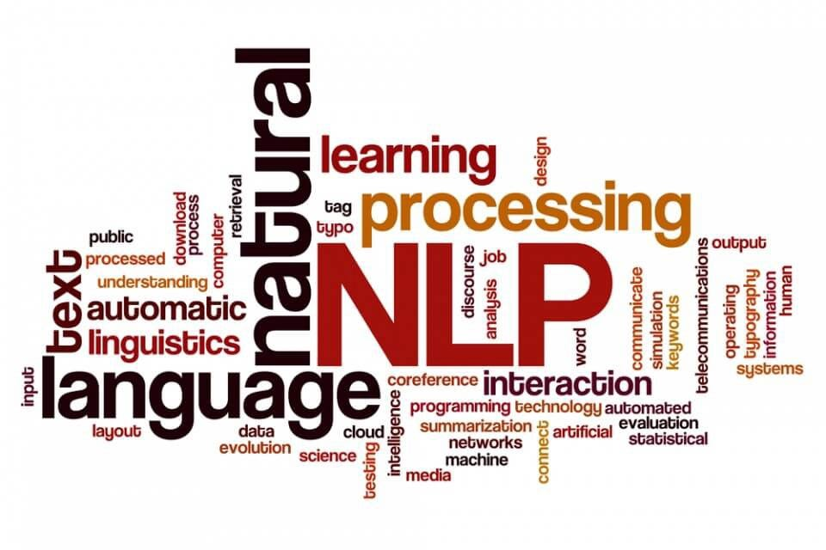
Traditional Linguistic Methods
Week 2
CSY3055 – Natural Language Processing
Dr Oluseyi Oyedeji

Slide 2
Learning Goals for Week 2
By the end of week two, you should be able to:
Use regular expressions (regex) for text cleaning and pattern extraction.
Explain tokenisation at word, sentence, and subword levels.
Compare stemming and lemmatisation, with their strengths and limits.
Describe segmentation in languages without spaces.
Discuss how tokenisation can create bias in multilingual NLP.

Slide 3
Relevance
Every NLP system, from Google Translate to ChatGPT, starts with these basic steps.
If text is cleaned or segmented wrongly, errors flow into the whole pipeline.
Regex, tokenisation, and segmentation lets NLP systems flow seamlessly
If AI is “smart”, why do we still need these simple rules?

Slide 4
Today’s Session
Regular Expressions (Regex)
Tokenisation
Ethics
Stemming & Lemmatisation
Segmentation

Slide 5
Regular Expressions (Regex)

Slide 6
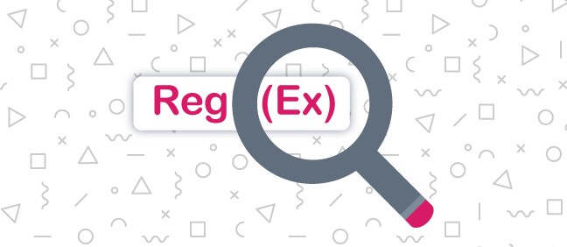
What is a Regular Expression (Regex)?
A regex is a pattern that matches text.
Example:
\d{3}-\d{2}-\d{4} matches a U.S. Social Security Number.
In NLP
regex helps us clean noisy text and extract useful pieces.

Slide 7
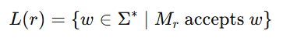
Regex and Finite Automata
Every regex = a finite automaton (a small machine that accepts or rejects strings).
Example: [a-z]+ → “match one or more lowercase letters”.
the set of all strings (w) that match regex (r).
When you run regex, you’re actually running a machine from automata theory!

Slide 8
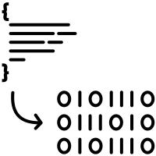
How Regex Becomes a Machine
Thompson’s Construction builds a nondeterministic finite automaton (NFA) from regex.
Example: (ab|c)* creates a machine that branches between ab or c.
Many tools (like compilers, search engines) rely on this principle.

Slide 9
Efficiency & Pitfalls
Deterministic Finite Automaton (DFA) = fast, linear time.
Backtracking engines (like Python’s re) can explode to exponential time.
Danger: (a+)+b → takes forever on long strings of a.
This is called catastrophic backtracking.
Why do we still use backtracking engines if DFA is faster?

Slide 10
Regex in NLP Tasks
Cleaning text
remove URLs, HTML tags, punctuation.
Extracting info
emails, hashtags, dates, phone numbers.
Bootstrapping Named Entity Recognition (NER)
first pass with regex before ML.

Slide 11
Code Demo: Regex in Python
Output: ['jane.doe@uni.edu'] ['#NLP']
import re
text = "Email: jane.doe@uni.edu #NLP"
emails = re.findall(r"\b[\w\.-]+@[\w\.-]+\.\w+\b", text)
tags = re.findall(r"(?<!\w)#[\w]+", text)
print(emails, tags)

Slide 12


Real NLP Applications of Regex
Clinical NLP
extract patient IDs from medical notes.
Social media analysis
find hashtags, mentions.
Legal NLP
locate contract dates, financial codes.
Regex is still essential, even in the deep learning era.

Slide 13

Limitations of Regex
Brittle
Fails on variation (“3 Oct” vs “October 3rd”).
Cannot capture nested structure (e.g., parentheses, long-distance rules).
Regex works best as a first filter, not the full NLP solution.

Slide 14
Tokenisation

Slide 15
What is Tokenisation?
Tokenisation means breaking text into units (tokens).
Example :
“I’m happy” → [I, ’m, happy].
Foundation for search engines, translation, language models.

Slide 16
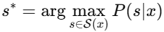
Tokenisation as Segmentation
Problem is how to split input (x) into best tokens (s).
pick the segmentation (s) that is most probable for input (x).
Do humans also “tokenise” when reading?
Notes:
Tokenisation can be seen as a segmentation problem, deciding how to split text into meaningful units. The model searches for the segmentation (s) that’s most probable given the input (x). In other words, it finds the most likely way to “cut” the text. This mirrors how humans also segment language mentally when reading or listening.

Slide 17
Word Tokenisation Challenges
Spaces are not enough!
Problems:
Contractions: “don’t → do + n’t”
Hyphens: “state-of-the-art”
Numbers: “3,000.5”
Tools like spaCy and NLTK handle these rules.

Slide 18
Sentence Tokenisation
“Dr. Smith went home. He slept.”
Is “Dr.” the end of a sentence? No.
Punkt Algorithm learns abbreviation patterns and sentence breaks.

Slide 19
Why Subword Tokenisation?
Infinite words; we cannot store them all.
Subwords solve the out-of-vocabulary (OOV) problem.
Examples:
“blockchain” → block + chain.
“unhappiness” → un + happi + ness.

Slide 20
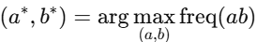
Byte Pair Encoding (BPE)
Algorithm
Start with characters.
Merge most frequent pair.
Repeat until vocab size reached.
merge the letters that appear together the most.
GPT tokenisers use this method.

Slide 21
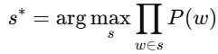
WordPiece & Unigram LM
WordPiece chooses segmentation that maximises sequence probability.
pick the split that makes the sentence most likely.
Unigram LM is a probabilistic model trained via Expectation-Maximisation (EM).

Slide 22
Tokenisation in Real NLP Systems
Search engines to index keywords.
Machine Translation for word alignment across languages.
Large Language Models (LLMs)
BERT = WordPiece.
GPT = BPE.
T5 = SentencePiece.
If GPT uses subwords, why does it sometimes cut words in funny places?

Slide 23
Code Demo: spaCy Tokeniser
import spacy
nlp = spacy.load("en_core_web_sm")
doc = nlp("Dr. Smith’s AI-based model is state-of-the-art.")
print([t.text for t in doc])
Output shows clean tokens, even with tricky hyphens.

Slide 24
Stemming vs Lemmatisation

Slide 25
Stemming
Stemming is the process of reducing inflected form of a word to one so-called “stem,” or root form
Rule-based truncation of words.
Example:
“caresses → caress”
“ponies → poni”.
Fast, but not always meaningful.

Slide 26
Lemmatisation
Lemmatisation is used to break a word down to its root meaning to identify similarities.
Lemmatisation uses dictionary with morphological analysis.
Example
“better → good”
“ate → eat”
Slower, but linguistically correct.

Slide 27
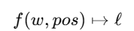
Lemmatisation as Normalisation
Given a word (w) and its part of speech (pos), return the base lemma (l).

Slide 28


NLP Applications
Stemming
Used in search engines to increase recall.
Lemmatization
Used in chatbots, MT, sentiment (preserves meaning).
Example
Sentiment system should know
“better = good”, not “bet”.

Slide 29
Code Demo: NLTK
from nltk.stem import PorterStemmer, WordNetLemmatizer
ps, wnl = PorterStemmer(), WordNetLemmatizer()
words = ["studies", "studying", "better", "ate"]
print([(w, ps.stem(w), wnl.lemmatize(w, "v")) for w in words])

Slide 30

Limitations
Stemming
Can be unrefined (university → univers).
Lemmatization
needs large lexicons.
Trade-off
speed vs accuracy.
When would you prefer speed over accuracy in NLP?

Slide 31
Segmentation

Slide 32
Why Segmentation?
Languages like Chinese, Japanese, Thai do not use spaces.
Without segmentation, it would be impossible to process certain texts
e.g. “我喜欢学习”

Slide 33
Maximum Matching
Maximum matching algorithm
Performs segmentation by greedily taking the longest word found in the dictionary
Greedy
take longest dictionary word.
Fast, but ambiguous.

Slide 34
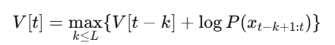
Statistical Segmentation (Viterbi)
Statistical segmentation uses probability models to decide where to split words in a sentence.
Use probabilities to choose best cut.
At each position, look back up to (L) characters and pick the split that makes the sentence most probable.

Slide 35
Example (Chinese)
Sentence
我喜欢学习
Possible segmentations
[我, 喜欢, 学习] = “I / like / study” - yes
[我, 喜, 欢学, 习] = – no
Probability model decides correctly.

Slide 36
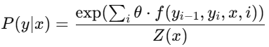
Conditional Random Field (CRF)
CRF = Conditional Random Field
CRF is a model for sequence labelling.
Labels
B = Begin, M = Middle, E = End, S = Single.
score all possible label sequences, normalise them, pick the best one.

Slide 37
Code Demo: Jieba Segmentation
import jieba
print(list(jieba.cut("我喜欢学习")))
Output: ['我', '喜欢', '学习']

Slide 38
Ethics & Bias

Slide 39
Token Inflation
English
“I love NLP” → 3 tokens.
Chinese:
“我喜欢自然语言处理” → ~10 tokens.
Same meaning, more tokens = unfair cost.

Slide 40
Impacts of Tokenisation Bias
Higher API costs for some languages.
Shorter usable context in LLMs for token-heavy scripts.
Models favour languages with more efficient tokenisation (often English).
Notes:
This slide highlights the ethical and practical implications of tokenisation bias in multilingual NLP systems. While tokenisation is a technical preprocessing step, its design can unintentionally privilege certain languages — typically English — by reducing their token count and therefore lowering computational and financial costs. The goal is to make students reflect on how algorithmic efficiency can translate into linguistic inequality, and to encourage critical thinking about fairness and inclusivity in AI design.

Slide 41
Towards Fairer Tokenisation
Masakhane (African NLP group) → work on better tokenisers for African languages.
Research question
Can we design tokenisers that treat languages equally?
Ethics in NLP is not only about biased data, but also about biased infrastructure.

Slide 42
Practical & Wrap-Up

Slide 43
Summary
Regex is a quick pattern matcher, but brittle.
Tokenisation is the foundation of all NLP pipelines.
Stemming vs Lemmatization = speed vs meaning.
Segmentation is mandatory for non-spaced languages.
Ethics = tokenisation choices create real-world unfairness.
How would you design a tokeniser for non-English languages?

Slide 44
Thank you

